Slide 1

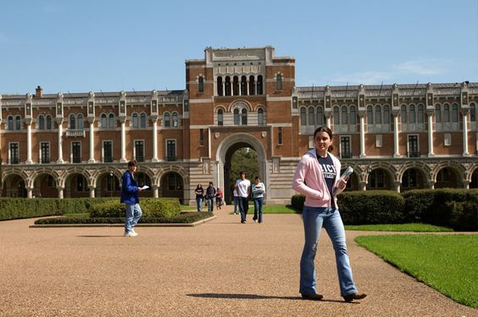
English
Lesson 7
That’s me!
My school

Slide 2


Greeting

Slide 3


Introduction. Aim of the lesson.
Aim of the lesson:
Today we’re going to learn about Present Simple and prepositions of time, to have practice in listening sounds of letter a, to write a paragraph about your school

Slide 4






The icons of the lesson
Reading
Listening
Writing
Speaking
Grammar
Vocabulary

Slide 5
General School Experience
1. What is your favorite subject at school and why?
2. Can you describe a typical day at school for you?
3. How do you feel about school? Is there anything you particularly enjoy or dislike?
4. What extracurricular activities are available at your school, and which one are you interested in?

Slide 6

Work with Student’s Book
Student’s Book
(ex.3, p.9)
GRAMMAR
Present Simple

Slide 7
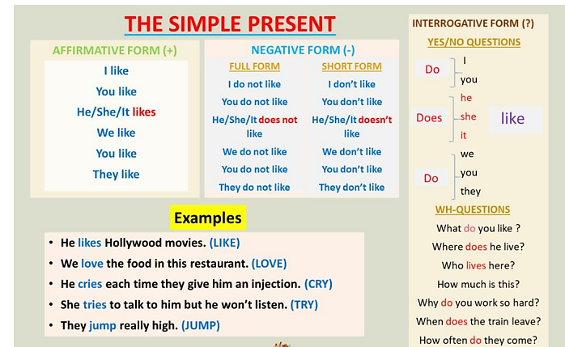
Grammar
A: What do you do every day after school?
В: I watch TV and then my sister and I play computer games

Slide 8
Preposition of time
at 7 a.m. /midnight/the weekend, etc.
in the morning /spring /March, etc.
on Thursday /Sunday evening /
weekdays, etc.
till/until 9pm /noon /Sunday, etc.
before/after lunch /school/11 p.m. etc.

Slide 9
Work with Student’s Book
Student’s Book
(ex.3, p.9)
Complete with the Present Simple of the verbs in brackets

Slide 10
Complete with the Present Simple of the verbs in brackets
1. William _______ (do) his homework when he ________(get) home.
2.A:_______you ________ (finish) school at 3 pm. on Fridays?
B: No, we __________(finish)at 1:30.
3. My mother ____________(not work) on Saturdays so she _________(go) shopping.
4. A: When_______ your brother _________(practice) the guitar?
B: Every day after school and he also ________(play) the guitar at the weekend.
5. Fay and Julie ____________(not stay) at home on Sundays. They ________(ride) their bikes in the park.
does
gets
Do
finish
finish
doesn’t work
goes
does
practice
plays
don’t stay
ride

Slide 11
Work with Student’s Book
Student’s Book
(ex.4, p.9)
PRONUNCIATION
a) Listen and repeat. What’s the difference between a, b and c?

Slide 12
What’s the difference between a, b and c?
a. lunch
b. lab
c. place

Slide 13



Gymnastics for the eyes

Slide 14

Work with Student’s Book
Student’s Book
(ex.4, p.9)
Listen and tick ( ) the sound you hear

Slide 15


Listen and tick ( ) the sound you hear
 | lunch /ʌ/ | lab/æ/ | place/eɪ/
maths
same
fun
information
subject
practice
study

Slide 16
Work with Student’s Book
Student’s Book
(ex.5, p.9)
a) Talk in pairs about your school. Use the ideas below.

Slide 17
Talk in pairs about your school
What's the name of your school?
Where is it?
How many teachers work there?
How many students are there?
What facilities are there at your school?
What time do classes start and finish?
What subjects do you do?
What are your favourite subjects?

Slide 18
Work with Student’s Book
Student’s Book
(ex.5, p.9)
b) Use the ideas from activity 5A to write a paragraph about your school

Slide 19
Work in Workbook
Workbook
(ex.1, p.8)
C) Complete with the Present Simple of the verbs in brackets

Slide 20
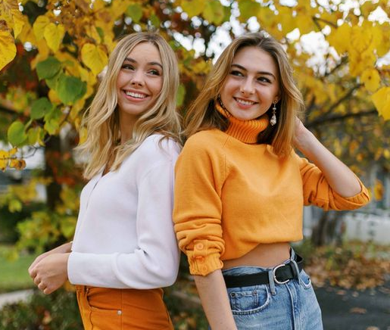
Complete with the Present Simple of the verbs in brackets
Tina and Mary are sisters but also best
friends. When they (1) ____(get) home
from school in the afternoon, they(2)
____(do) their homework. Then they (3) ______(listen) to music and (4) _____(talk). In the evening, Tina (5) ______ (play) computer games and Mary (6) _______ (watch) TV. Mary (7)___________ (not like) computer games.
get
do
listen
talk
plays
watches
doesn’t like

Slide 21
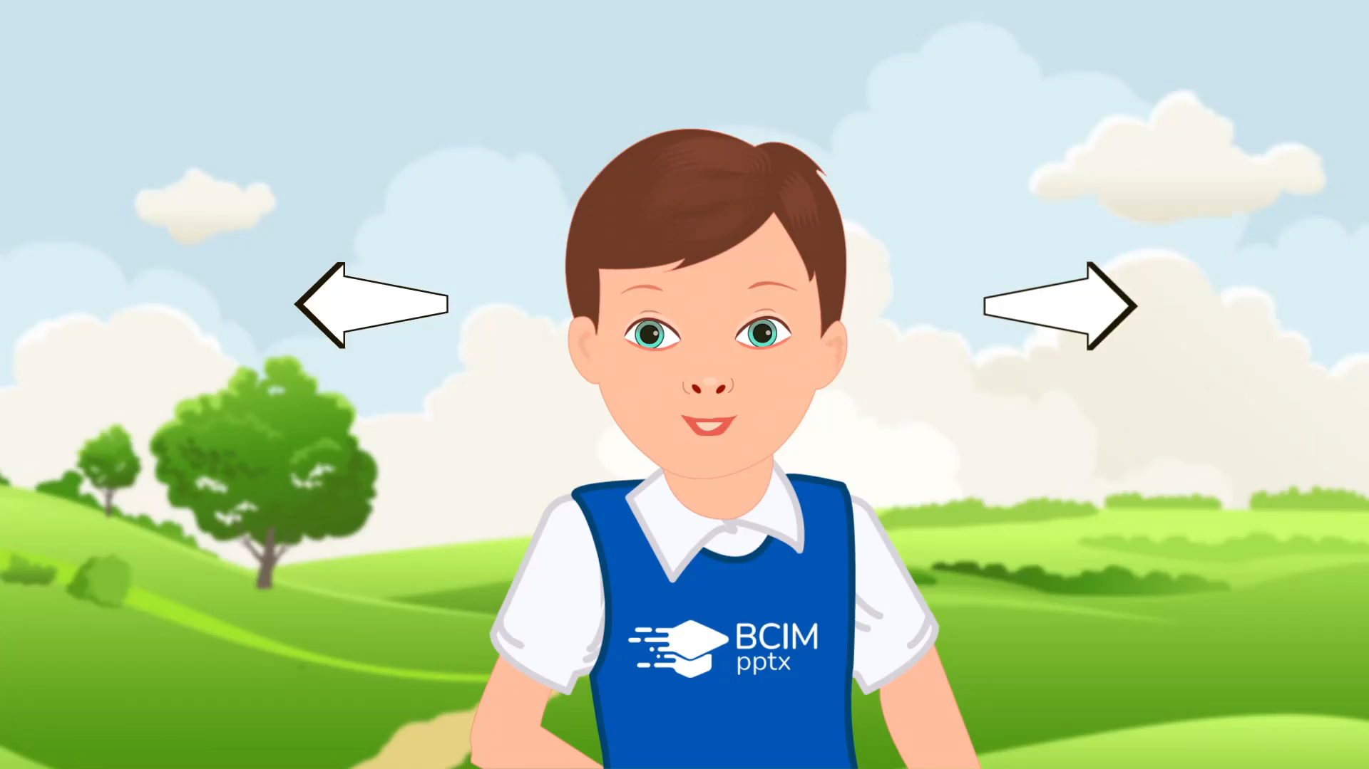
Gymnastics for the eyes

Slide 22
Work in Workbook
Workbook
(ex.1, p.9)
D) Complete with do, does, don’t or doesn’t

Slide 23


Complete with do, does, don’t or doesn’t
A : _____ your friends go to the cinema every weekend?
B : Well, they ________ go to the cinema but they watch DVDs every weekend.
Do
2. A: _______ Rob play tennis in his free time?
B: Yes, he ________
Does
don’t
does

Slide 24
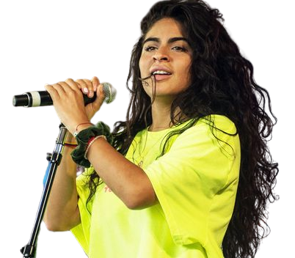
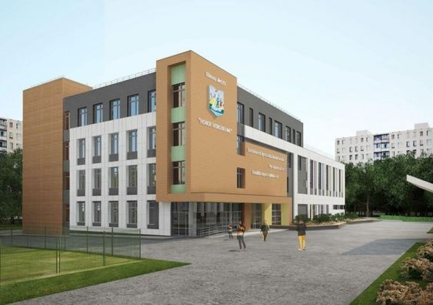
Complete with do, does, don’t or doesn’t
3. A : _____ Sandra want to became a dancer?
B: No, she ___________. She wants to become a singer.
Does
4. A: _____ you like your new school?
B: No, I _______ . It’s very small.
Do
doesn’t
don’t

Slide 25
Work in Workbook
Workbook
(ex.1, p.9)
E) Circle the correct words

Slide 26

Complete the sentences with the words in the box
(1) On/In weekdays I haven’t got free time because I’ve got homework every day. So, (2) in/at weekend I want to have fun. (3) In/On Saturday morning I get up (4) after/till eleven o’clock, have a big breakfast and go to the park with my friends. We play football (5) till/before two o’clock and then I go home and have lunch with my family. (6) After/Before lunch I play computer games or watch TV and (7) in/on the evenings my friends and I go to fast food restaurant. (8) At/On Sundays I get up (9) at/till ten and (10) in/at midday I have lunch with my best friend. (11) In/On the evening I go to the cinema or watch a DVD. Then it’s back to school (12) till/on Monday.

Slide 27
Work in Workbook
Workbook
(ex.1, p.9)
F) Complete with the sentences a-f

Slide 28
Complete with the sentences a-f
Interviewer: Hello, I’m from Teen Life magazine.
Can I ask some questions about your
school?
Jennifer: Sure.
Interviewer: Thank you. (1) ________
Jennifer: About fifteen, I think.
Interviewer: (2) ________
Jennifer: I don’t know. There are thirty in my
class.
Interviewer: OK. And …(3) ________
Jennifer: At 8:30 am and they finish at 4 pm.
Interviewer: That’s seven and a half hours. (4)
______
Jennifer: Summerled.
Interviewer: Ahh…Ok. (5) _______
Jennifer: I like Art and Music. (6) _________
How many students are there?
What’s the name of your school?
What time do classes start?
What are your favorite subjects?
They’re great fun
How many teacher work at your school?
f
a
c
b
d
e

Slide 29
School Memory Book
Have students compile a memory book that includes short stories, poems, or anecdotes about their memorable experiences at school. They can add illustrations, photographs, or collages to make it visually engaging. This task encourages reflection and creativity

Slide 30

Ending of the lesson. Summarizing.
What task was the most easy/difficult?

Slide 31

Ending of the lesson. Say “Goodbye!”

Slide 32
Використані джерела:
https://online.flippingbook.com/view/818861536/4/
https://vsimpptx.com/

