Slide 1

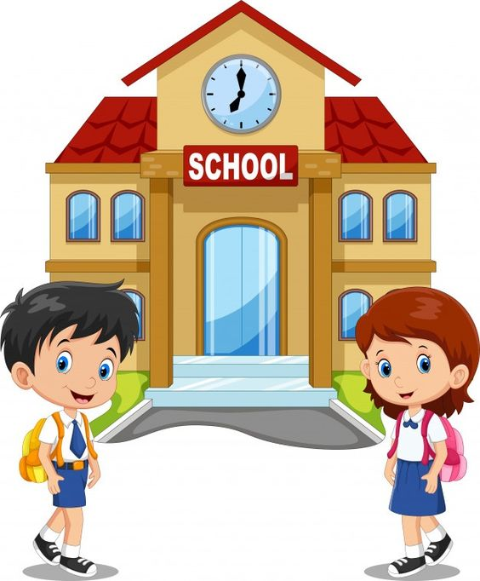
English
Lesson 6
That’s me!
At School

Slide 2


Greeting

Slide 3


Introduction. Aim of the lesson.
Aim of the lesson:
Today we’re going to learn Module 1 “That’s me!” with topic about school, will repeat the school subjects , to read about unusual school and do tasks about text

Slide 4






The icons of the lesson
Reading
Listening
Writing
Speaking
Grammar
Vocabulary

Slide 5
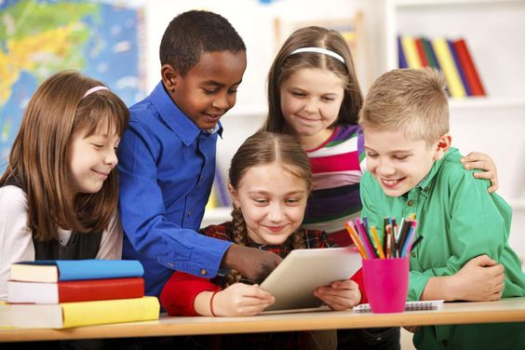
Discuss
What's your favourite school subject?
What do you do in your free time?
What kind of clothes do you like
wearing?

Slide 6
In this module you will learn...
to talk about school life
to talk about your dally routines
to describe appearance
to give your opinion about clothes and fashion
to talk about things that are happening now
to talk about temporary situations
to distinguish between habitual actions and things that are happening now
to talk about free-time activities
to say what you like and don’t like doing
to say what you want or would like to do
to describe personality
to write about yourself and your best friend

Slide 7

Work with Student’s Book
Student’s Book
(ex.1, p.8)
VOCABULARY
Listen and repeat the school subjects below. Then look at the pictures and decide where you do each of the subjects

Slide 8
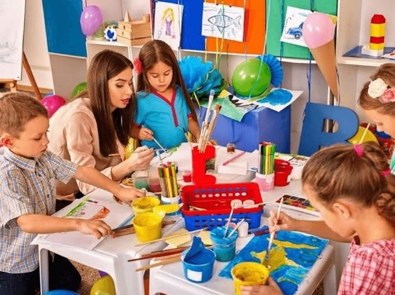
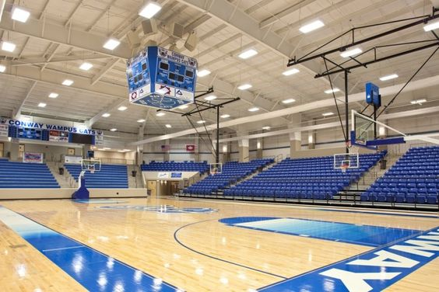
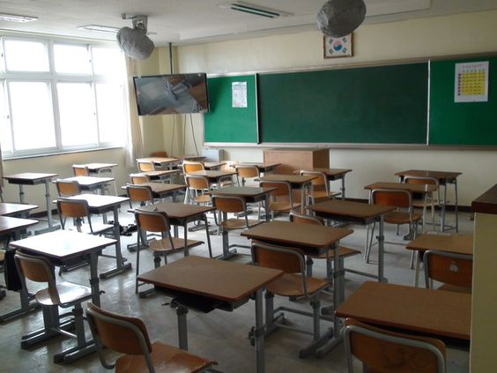
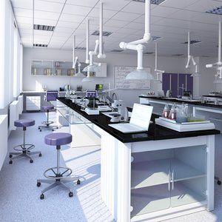
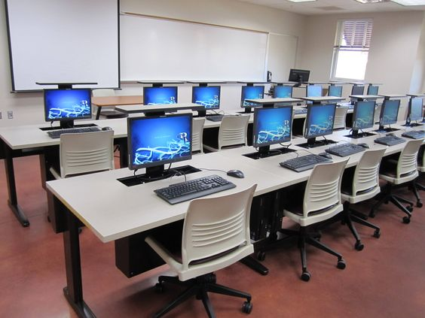
Listen and repeat the school subjects below
history biology geography chemistry PE ( Physical Education) ICT( Information and Communications Technology) physics maths art
art room
gym
classroom
science lab
computer class

Slide 9
Look at the pictures and decide where you do each of the subjects
art room: art
science lab: biology, chemistry, physics
gym: PE
classroom: history, geography, maths
computer room: ICT

Slide 10
Work with Student’s Book
Student’s Book
(ex.2, p.8)
A) Look at the pictures and the title of the text. How do you think Mellway is different from other schools? Listen, read and check your answers

Slide 11
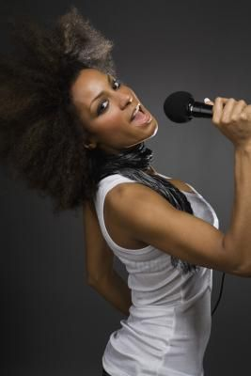
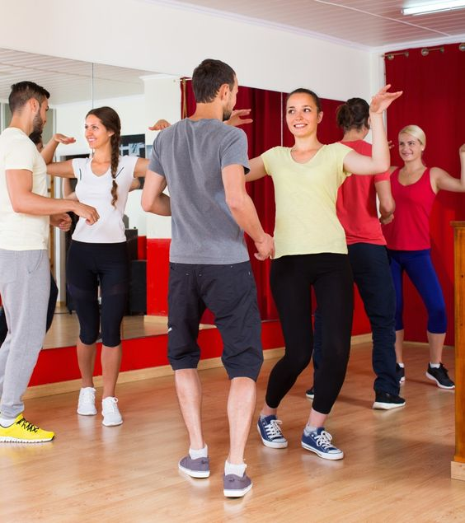
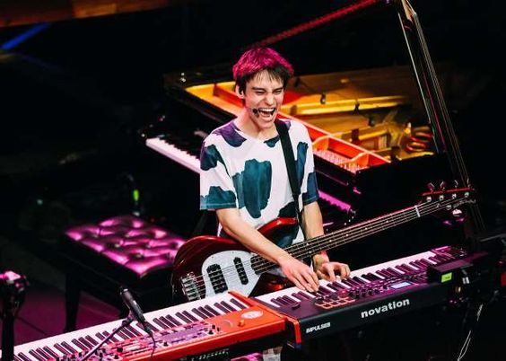

Look at the pictures and the title of the text
MELLWAY
School for performing arts
The students at Mellway are 14-19 years old. They do the same subjects as other secondary school, like maths, history, geography etc., but they also learn music and dance.

Slide 12

How do you think Mellway is different from other schools?
Libby Kingsley, a fifteen-year-old student says:
“Mellway is a great school. Classes start at 8:45 am every day and they finish at
4 o’clock on most days. On Fridays they don’t finish at 4:00. They finish at 2:30,
but I stay till 5 o’clock and practice with my friends. I want to become a singer,
so Mellway is perfect for me.”

Slide 13
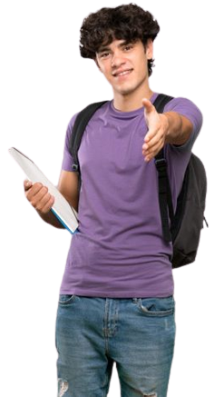
How do you think Mellway is different from other schools?
Theo Hunt a fourteen-year-old
student says:
“My favourite subject is moden dance. You see I like hip hop. Its great fun! The facilities at Mellway are excellent. My favourite place is the theatre. It’s very big and at the end of school in July, we give a dance performance there.”

Slide 14
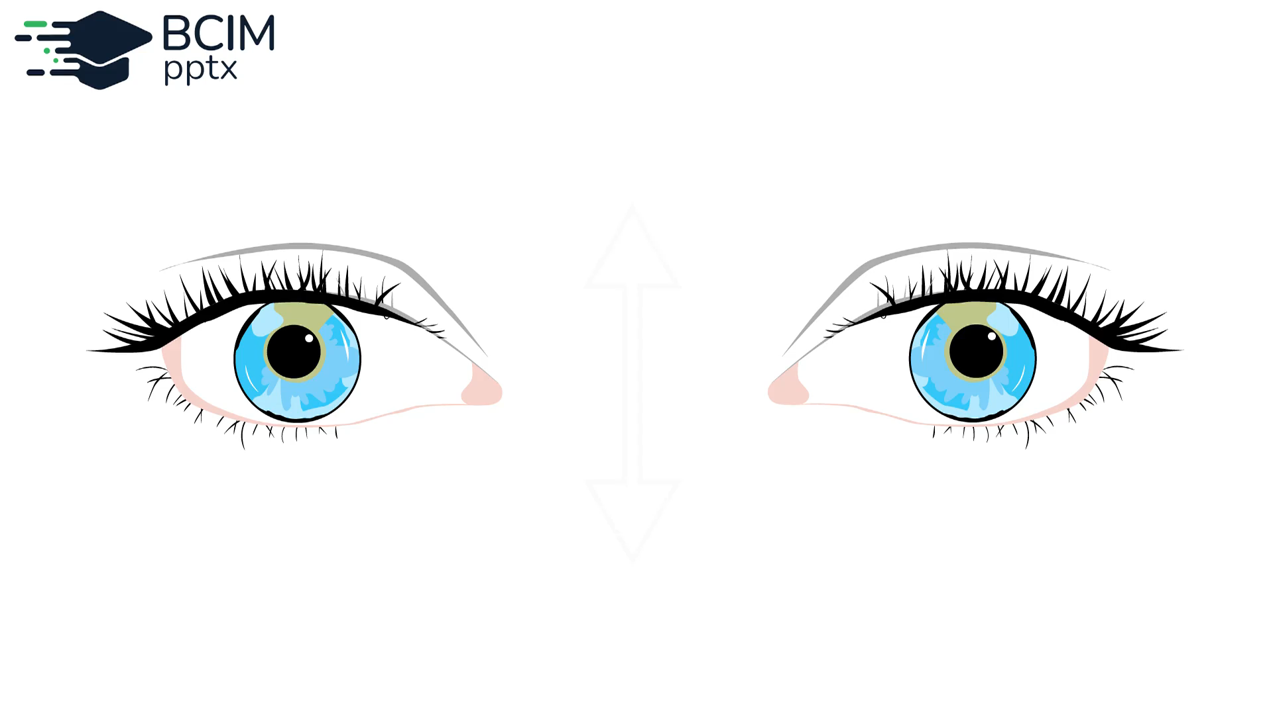


Gymnastics for the eyes

Slide 15
Work with Student’s Book
Student’s Book
(ex.2, p.9)
Read again and answer the questions

Slide 16
Read again and answer the questions
1. What subjects do students do at Mellway?
2. What time do classes start?
3. What time do classes finish on Thursdays?
They do the same subjects as other secondary schools like maths, history, geography, etc., but they also learn music and dance.
They start at 8:45 am
They finish at 4 o’clock

Slide 17
Read again and answer the questions
4. Does Libby stay at school after 2:30 on Fridays?
5. What does Theo say is great fun?
6. What do they do at the theatre at the end of
school In July?
Yes, she does
Hip hop
They give a dance performance

Slide 18
Work in Workbook
Workbook
(ex.1, p.8)
A) Find seven subjects in the grid. Then write them under the correct picture

Slide 19
(to open аn interactive task, click on the orange rectangle)
Open an online interactive task

Slide 20
Work in Workbook
Workbook
(ex.1, p.8)
B) Complete the sentences with the words in the box

Slide 21
Complete the sentences with the words in the box
secondary modern gym facilities lab learn start practice
I like __________ dances like hip hop and R&B. They’re great fun.
John is 13 years old. He’s in _____________ school.
We always have PE in the ________________.
On Friday mornings I have chemistry in the science __________.
We __________ classes at 8:30 in the morning.
I _________ the guitar for 2 hours every day.
This school’s got excellent ___________.
We ___________ three languages at our school.
modern
secondary
gym
lab
start
practice
facilities
learn

Slide 22
Design a New Classroom
Have students imagine they have been given the task of designing a completely new and innovative classroom. They can create written descriptions, sketches, or even a digital presentation to showcase their ideas. This activity encourages descriptive writing and critical thinking

Slide 23

Ending of the lesson. Summarizing.
What task was the most easy/difficult?

Slide 24

Ending of the lesson. Say “Goodbye!”

Slide 25
Використані джерела:
https://online.flippingbook.com/view/818861536/4/
https://vsimpptx.com/

