Slide 1
School things

Slide 2






Slide 7


Slide 10
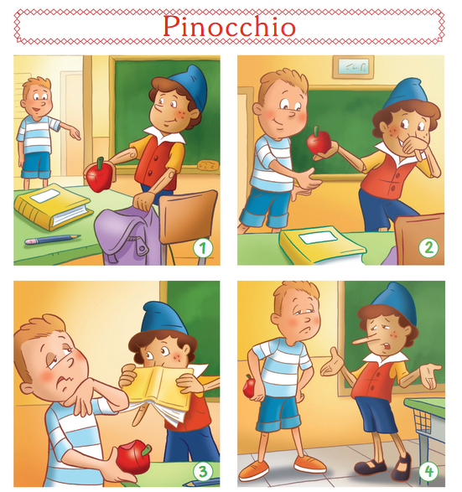
Hi Pinocchio!
What’s that?
It’s an apple.
Here.
Okey, it’s a rubber.
Yuck!
Pinocchio!

Slide 11




What`s that?
It’s a…

Slide 12
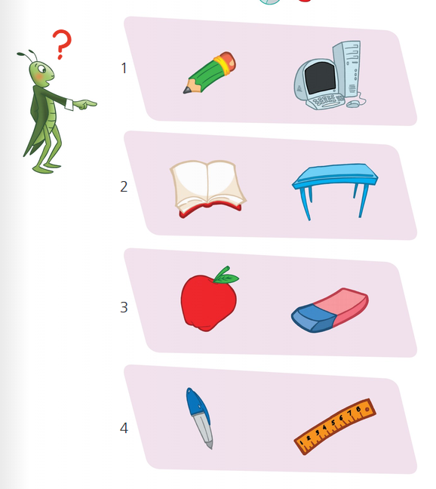

Slide 13
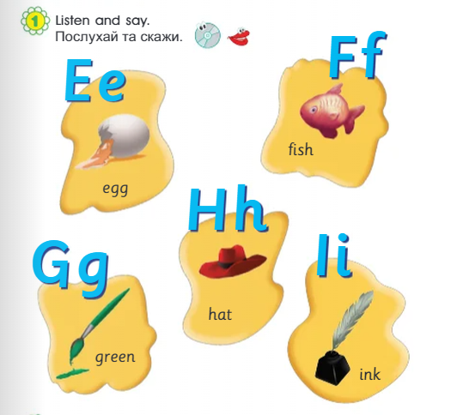

Slide 14


Slide 15
Використані джерела:
https://online.flippingbook.com/view/956905607/4/
https://www.mmpublications.com/Ukraine/SmartJunior1.html

