Slide 1

School things!

Slide 2






Slide 7



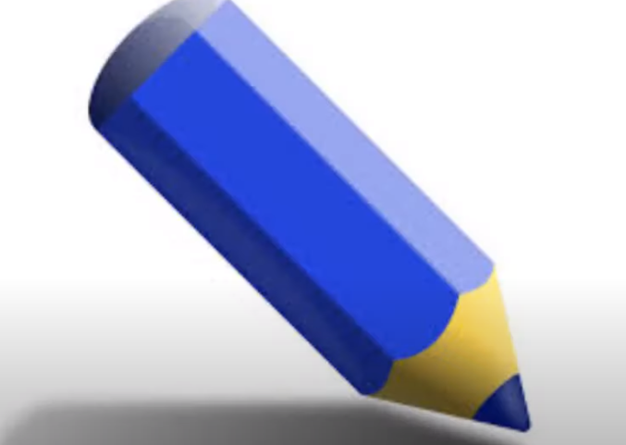

Slide 8
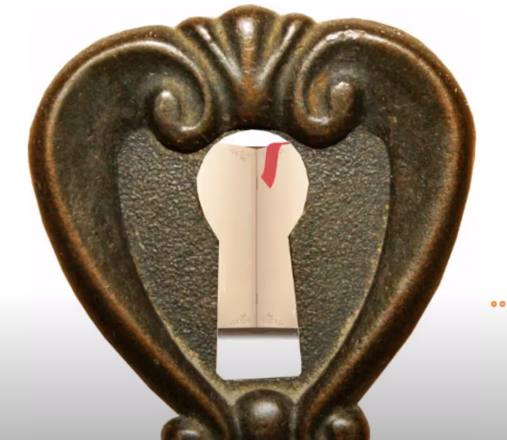


Slide 9

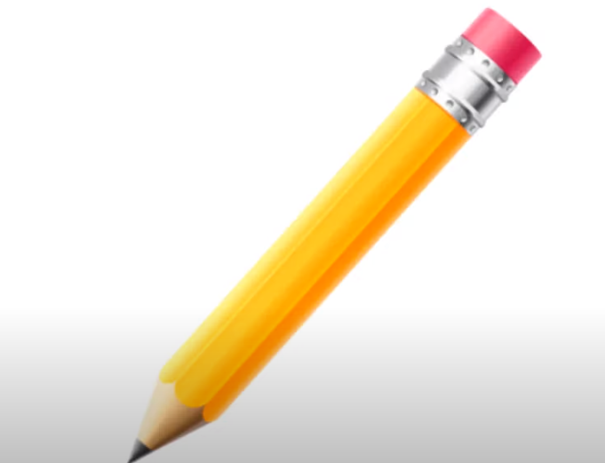

Slide 10
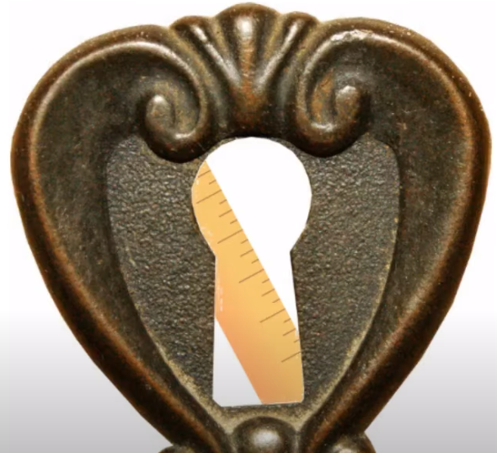


Slide 11

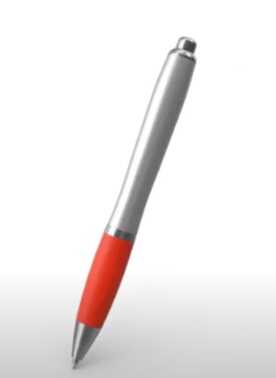

Slide 12
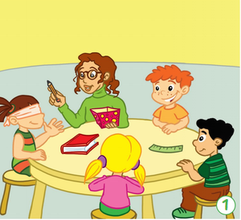
What`s this?

Slide 13
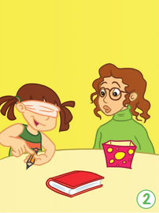
It`s a pen.
No

Slide 14
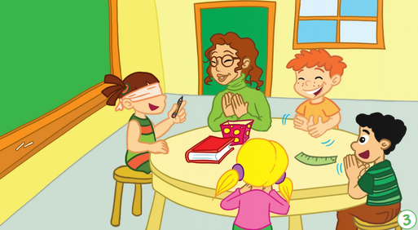
It`s a pencil.

Slide 15
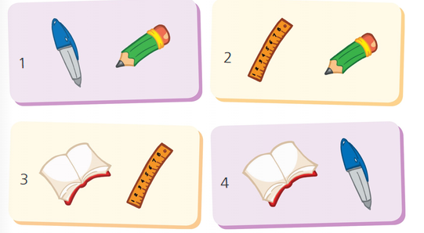

Slide 16
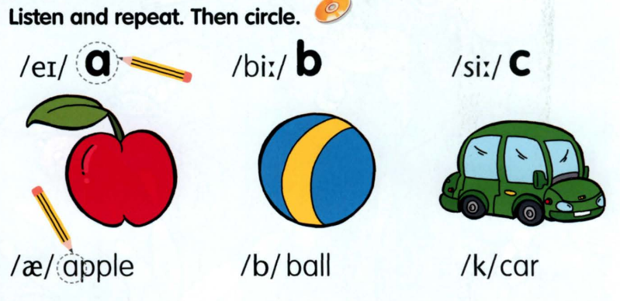

Slide 17
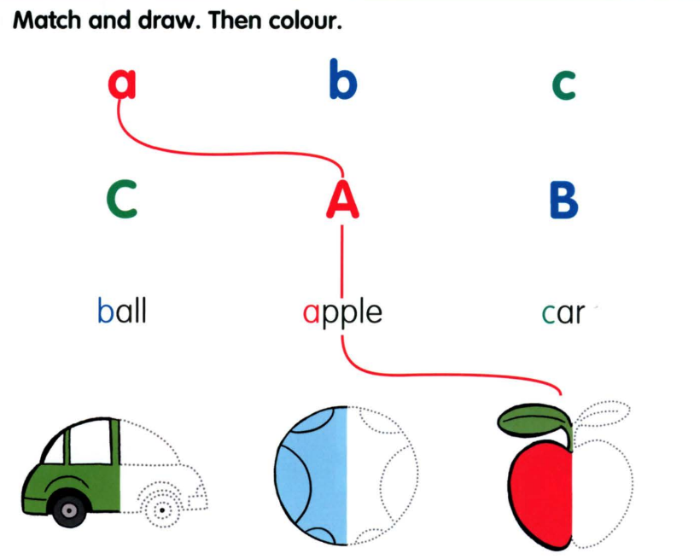

Slide 18
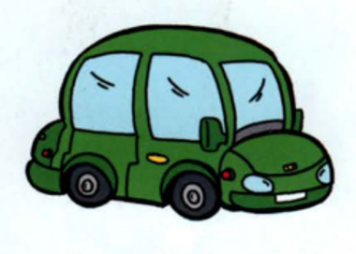
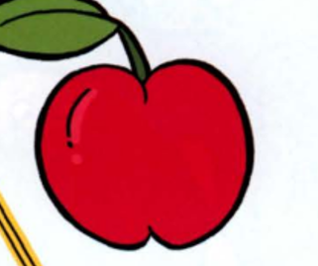


Slide 19
ant
dad
an
act
and
a
cat
apple

Slide 20
Використані джерела:
https://online.flippingbook.com/view/956905607/4/
https://www.mmpublications.com/Ukraine/SmartJunior1.html

