Slide 1
Colours

Slide 2
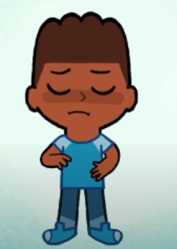
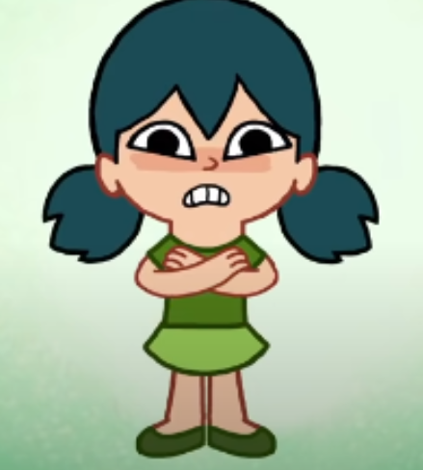
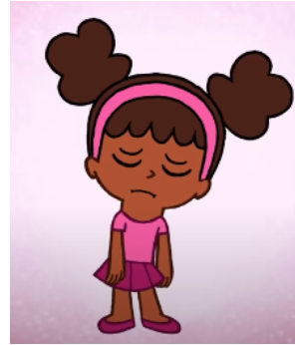
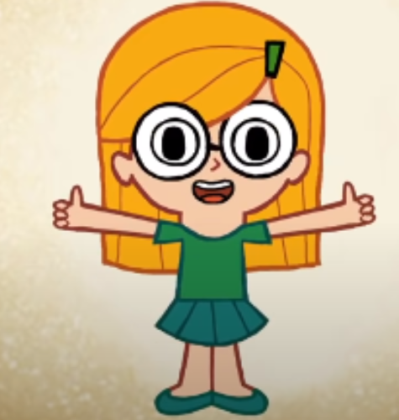
How are you?
I`m hungry
I`m not so good
I`m tired
I`m good

Slide 3






Slide 8

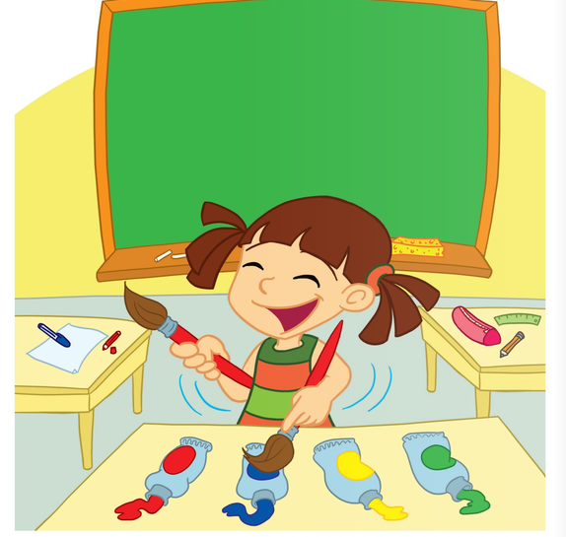





Slide 9

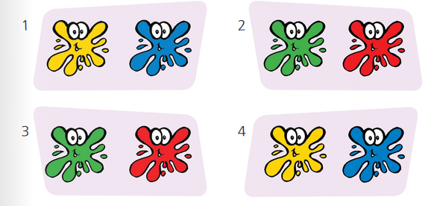

Slide 10
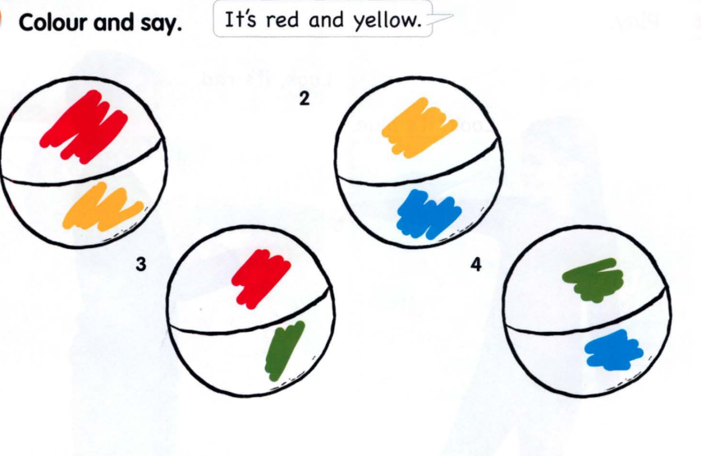

Slide 11
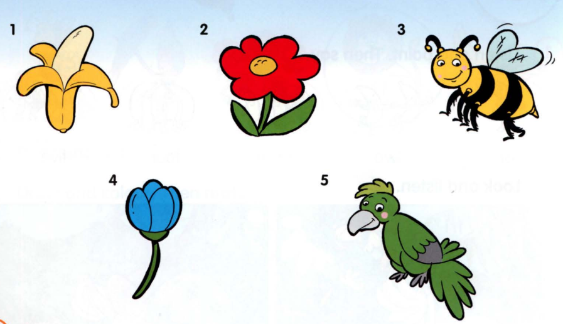

Slide 12
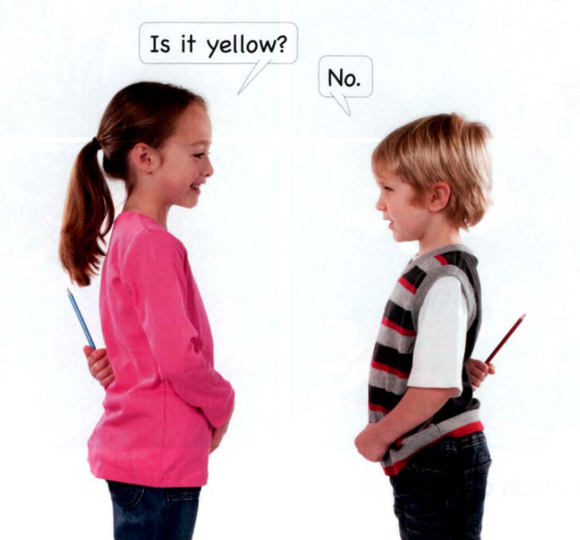

Slide 13








Is it…?
Yes
No

Slide 14
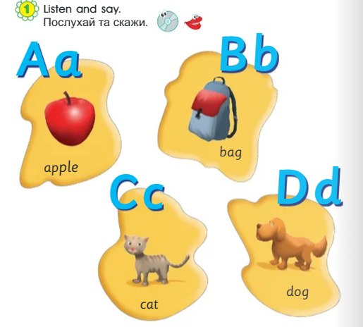

Slide 15
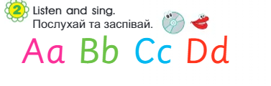

Slide 16


Slide 17
Використані джерела:
https://online.flippingbook.com/view/956905607/4/
https://www.mmpublications.com/Ukraine/SmartJunior1.html

