Slide 1
Story time!

Slide 2


Slide 3
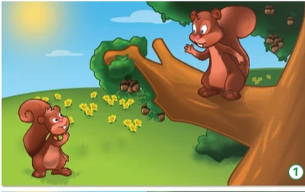
Hello, I’m Pip. What`s your name?
Hello Pip.
My name’s Skip.

Slide 4
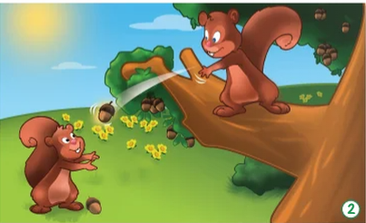
One, two…

Slide 5
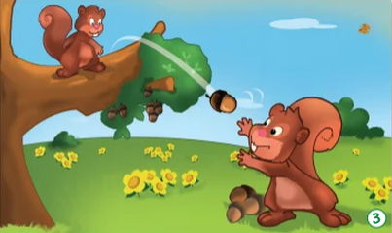
Three, four…

Slide 6
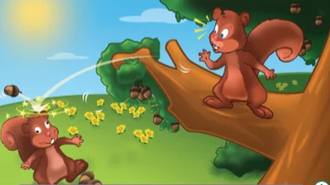
Five…
Ouch…
Sorry…

Slide 7


Slide 8


Slide 9


Slide 10
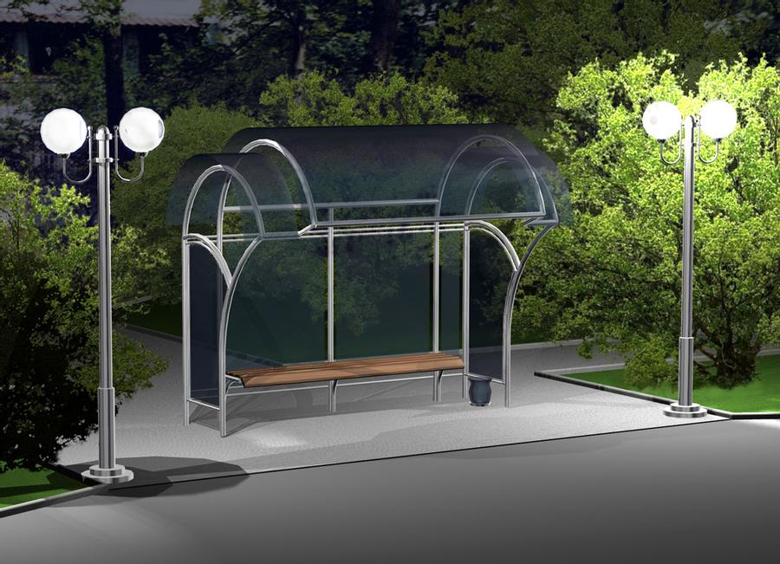
A
A
a
a
A
A a
a
a

Slide 11
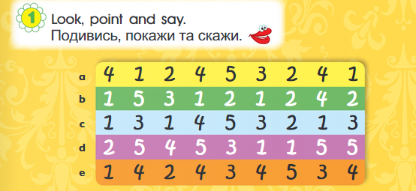

Slide 12
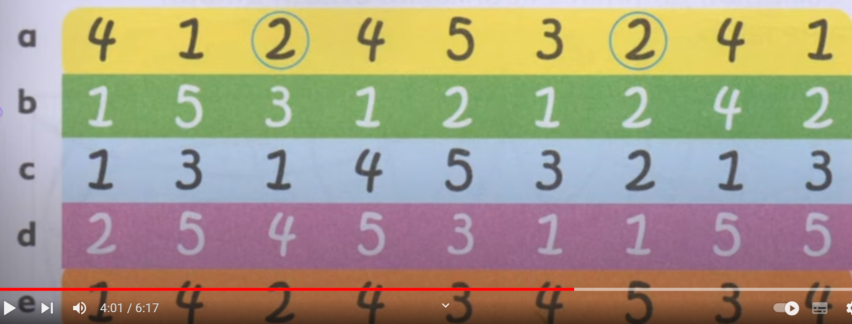


Slide 13


Slide 14
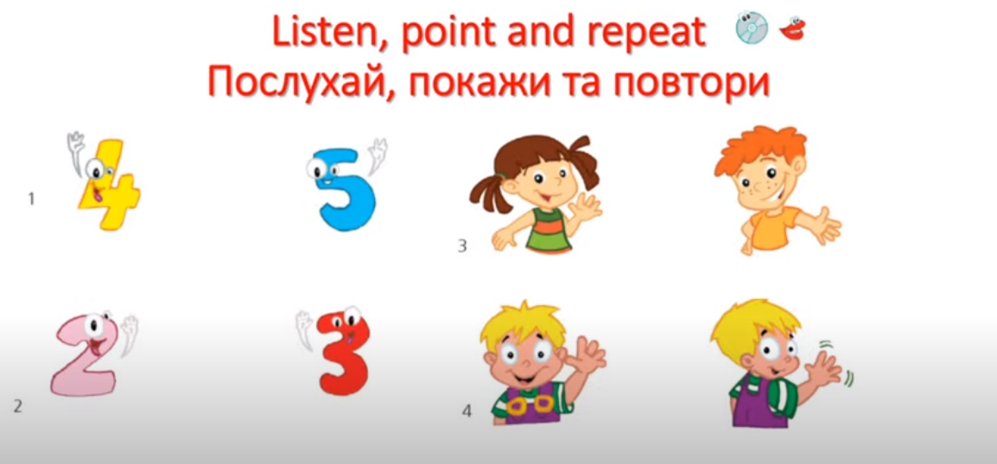

Slide 15


Slide 16


Slide 17
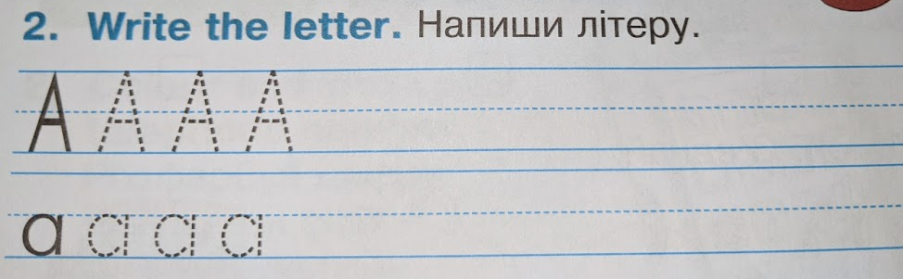

Slide 18
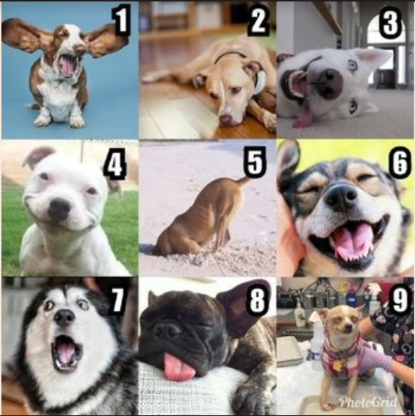

Slide 19
Використані джерела:
https://online.flippingbook.com/view/956905607/4/
https://www.mmpublications.com/Ukraine/SmartJunior1.html

