Slide 1

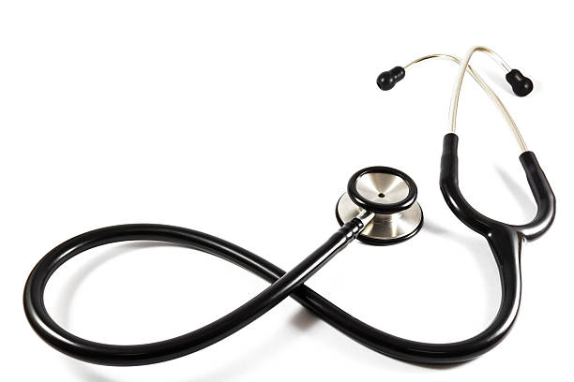
English
Lesson 57
A sound mind in a sound body
Doctor! Doctor!
Health Service

Slide 2



Greeting

Slide 3


Introduction. Aim of the lesson.
Aim of the lesson:
Today we’re going to learn the new vocabulary, to read and talk about Health Service.

Slide 4







The icons of the lesson
Reading
Listening
Writing
Speaking
Grammar
Vocabulary

Slide 5

Work with Student’s Book
Student’s Book
(ex.1, p.111)
a) Work in pairs. Ask and answer the questions them.

Slide 6
a) Work in pairs. Ask and answer the questions them.
When does your mother call in a doctor?
Why should you take medicine when you are ill?
When do people catch the flu?
Is your health very good, good or poor?
Where do you go when you have a bad tooth?
What should you do to keep fit?

Slide 7
Work with Student’s Book
Student’s Book
(ex.1, p.111)
b) Match the texts with the questions above.
(There is one extra question).

Slide 8
Match the texts with the questions. (There is one extra question). Fill in a number.
5
When you have a bad tooth, you go to the dentist’s office.
1
When you feel ill, your mother calls in the doctor.
When does your mother call in a doctor?
Why should you take medicine when you are ill?
When do people catch the flu?
Is your health very good, good or poor?
Where do you go when you have a bad tooth?
What should you do to keep fit?
2
The doctor gives you some medicine. In a short time you’ll get better and be in good health. You’ll be able to go back to school.
6
3
Try to keep fit. Then you’ll be in good health. You should do morning exercises. You should play sports and stay outdoors every day. You should eat a lot of fruits and vegetables and other healthy food.
In cold seasons many people catch colds. When you have a cold, you have to drink a lot of hot tea. A bad cold is called a flu. When you have a flu, you can give it to other people around you. So, you must stay at home.

Slide 9
Introduction of the vocabulary. Listen and repeat.
VOCABULARY BOX
an accident [‘æksɪdənt]
a disease [dɪ‘zi:z]
a dentist office [‘dentɪst ‘ɒfɪs]
a pill [‘pɪl]
a surgeon [‘s3:dƷən]
a symptom [‘sɪmptəm]
a treatment [‘tri:tmənt]
private [‘praɪvɪt]
regular [‘regjυlə]
regularly [‘regjυləlɪ]
to make an appointment [‘meɪk ə‘pᴐɪngtmənt]

Slide 10
(to open аn interactive task, click on the orange rectangle)
Open an online interactive task

Slide 11
Work with Student’s Book
Student’s Book
(ex.2, p.112)
Read the article and choose the sentence (A-E) that best fits each gap (1-5).

Slide 12

Read the sentences.
Doctors visit their patients at hospitals regularly.
There are two other useful things for your health: take vitamins regularly and have a complete physical once a year.
So you have to make an appointment.
You have to pay there, but it’s usually quick.
A specialist will examine you and prescribe some treatment, pills, tablets or other medicine, which you can buy at the chemist’s.

Slide 13
Read the article and choose the sentence (A-E) that best fits each gap (1-5).
Doctors visit their patients at hospitals regularly.
There are two other useful things for your health: take vitamins regularly and have a complete physical once a year.
So you have to make an appointment.
You have to pay there, but it’s usually quick.
A specialist will examine you and prescribe some treatment, pills, tablets or other medicine, which you can buy at the chemist’s.
People need to see doctors if they have a cough, a high temperature or some other symptoms of some diseases. If you are ill you should see your local doctor first. (1) __________________________________________. As disease is usually characterized by a set of specific symptoms and signs, the doctor will ask you to describe the symptoms of your illness. Then he’ll take your pulse, look at your tongue, listen to your heart and lungs and check your temperature. He or she will give you some treatment or send you to see a specialist.
Specialists usually work in medical centers or in hospitals.
(2) __________________________________________________________________________
_____________________________________________________________________________.
So you have to make an appointment
A specialist will examine you and prescribe some treatment, pills, tablets or other medicine, which you can buy at the chemist’s

Slide 14
Read the article and choose the sentence (A-E) that best fits each gap (1-5).
Doctors visit their patients at hospitals regularly.
There are two other useful things for your health: take vitamins regularly and have a complete physical once a year.
So you have to make an appointment.
You have to pay there, but it’s usually quick.
A specialist will examine you and prescribe some treatment, pills, tablets or other medicine, which you can buy at the chemist’s.
If you feel too ill to go to the doctor’s, you’ll stay in bed and send for a doctor. If you have an accident, you go to the Accident and Emergency department of the nearest hospital. Sometimes people need to stay at the hospital for several days or weeks. Surgeons make operations, nurses take care of patients. (3) ________________________________________.
There are many private hospitals today. So you can go to a private doctor or a dentist. (4) __________________________________________. Today many people can get private treatment.
To be healthy a person needs to live a healthy lifestyle: do regular physical exercises, be outdoors every day, eat only healthy food and get enough sleep.
(5)____________________________________________________________________________________________________________________________________________________.
Doctors visit their patients at hospitals regularly.
You have to pay there, but it’s usually quick.
There are two other useful things for your health: take vitamins regularly and have
a complete physical once a year.

Slide 15
Work with Student’s Book
Student’s Book
(ex.3, p.113)
Say if it is true or false.

Slide 16
Say if it is true or false.
If you have some symptoms of any disease you should make an appointment with a doctor.
If you are ill you should see a surgeon first.
Specialists usually work at the dental offices.
You should tell the doctor about the symptoms of your disease.
You can buy pills, tablets and other medicine at the hospital.
When somebody has an accident he goes to a specialist.
TRUE
FALSE
FALSE
TRUE
FALSE
FALSE

Slide 17
Say if it is true or false.
TRUE
7. Surgeons make operations in hospitals.
8. Nurses take care of sick people.
9. You needn’t pay at the private dentist office.
10. A healthy lifestyle helps you keep fit.
11. To have a healthy lifestyle means to take vitamins regularly.
TRUE
FALSE
TRUE
FALSE

Slide 18
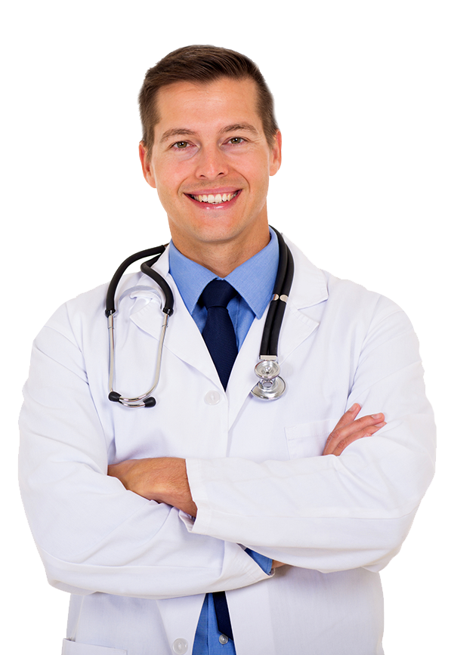
Complete the sentences. Choose the correct variant and circle it.
1. People need to see … if they have a cough, a high temperature or some other symptoms of some diseases.
nurses
surgeons
doctors
2. Specialists usually work in … or in hospitals.
office
medical centers
(at) home
3. If you have an accident, you should go to … of the nearest hospital.
the Accident and Emergency department
the Health department
the Policeman department
4. Today many people can get … treatment.
international
private
modern
5. A healthy lifestyle means …:
doing sports
taking vitamins
doing regular physical exercises, being outdoors every day, eating only healthy food and getting enough sleep

Slide 19
(to open аn interactive task, click on the orange rectangle)
Open an online interactive task

Slide 20
Work in Workbook
Workbook
(ex.3, p.60)
Match the words in both column and copy them.

Slide 21
Work in Workbook
Workbook
(ex.4, p.60)
Circle the word that goes with the picture.

Slide 22

Ending of the lesson. Summarizing.
What have you done at the lesson today?

Slide 23

Ending of the lesson. Say “Goodbye!”

