Slide 1





Past Simple Passive Voice
with N.P.Boiko

Slide 2



Let's study
The difference between the active and the passive voice
When we use an active verb, we say what the subject does.
When we use the past passive voice
How we make sentences in the past passive voice
She cleaned the room yesterday.
When we use a passive verb, we say what happens to the subejct.
The room was cleaned yesterday.

Slide 3


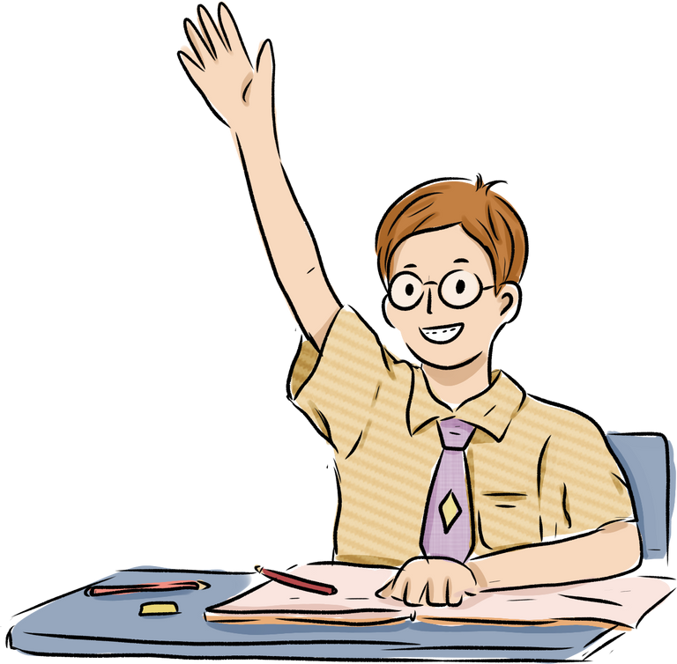

How to change the active to the passive voice
When we want to focus on the action and not who/what did it
They invited one hundred people to the wedding.
One hundred people were invited to the wedding.
active: invited
passive: were invited
Somebody stole my car.
My car was stolen!
active: stole
passive: was stolen

Slide 4


When we use the passive voice
If we want to mention the agent (the doer of the action), we just add by at the end of the sentence.
This house was built by my grandfather.
When the subject is in singular (I, he, she, it), we use was, and in plural (we, you, they) - were
past participle
was / were

Slide 5
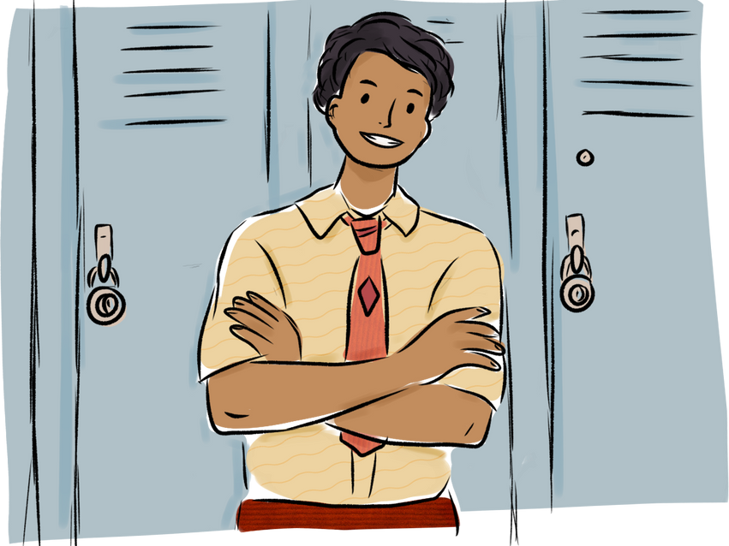
Instead of using somebody, they, people etc., write a passive sentence.
They employed thousands of people.
Thousands of people were employed
While I was doing the shopping, my bike was stolen.
Somebody stole my bike while I was doing the shopping.

Slide 6

Writing (p.146, ex.1):
Put the verbs in brackets into the past passive form. Get one point for each correct sentence:
1 The myth about Loch Ness … (to create) by Scottish people.
2 The legends about Robin Hood … (to pass) from generation to generation.
3 Peter Pan … (to write) by Scottish novelist and playwright J.M. Barrie.
4 This novel … (to admire) by audience in London.
5 The character of the film … (to love) by many.
6 The song … (to sing) by John Lennon.

Slide 7


Speaking (p.147, ex.3):
Use a toy microphone and make up a micro dialogue. Get from one to two points for each dialogue. Use the given example:
Example :
- Was the … written by….?
- Yes, it was. / No, it wasn’t. It was written by …
Writing CONTEST (p.147, ex.4):
Complete the sentences with passive structures of the verbs in brackets.
1. The cinema ... ( invent) in France.
2. St. Sophia Cathedral in Kyiv ... (build) in the 11th century.
3. Mona Lisa ... (paint) by Leonardo da Vinci.
4. David Copperfield ... (write) by Charles Dickens.

Slide 8


HOME ASSIGNMENT:
  Revise the rules about Present and Past Simple Passive Tenses;
  p.148, ex.5,6 – do the exercises in your copybooks.

Slide 9


Thank you!

